Slide 1

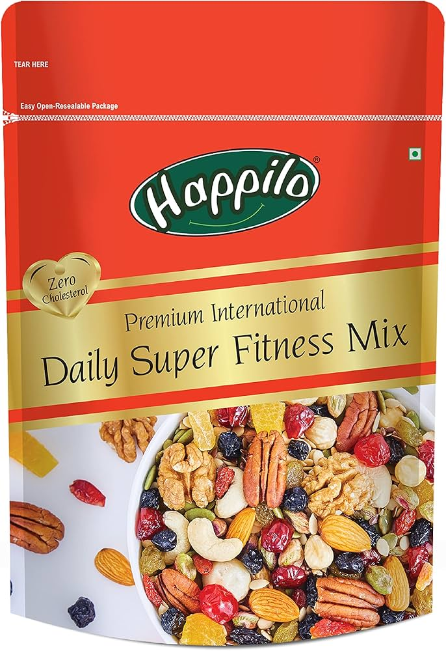
Happilo
Every Bite is a celebration of Health

Slide 2
Decoding Business Success: Company ,Product & Revenue
Company:
Happilo is a popular Indian brand that specializes in healthy snacks like dried fruits, nuts, seeds, and trail mixes. They focus on providing highquality, natural products that appeal to people who are healthconscious and looking for nutritious snack options. The brand is known for offering premium products that make snacking both healthy and enjoyable. You can find Happilo’s products in stores and online, making it easy for a wide range of consumers to access their nutritious offerings.
Manufacturing and R&D : Banglore
Investors: A91 Partners, Motilal Oswal Private Equity, and Venture Garage.
Valuation:(as of 2023) $192M
Product & Unique Proposition:
Happilo offers a diverse range of products primarily centered around healthy snacking. Their product lineup includes:
Dried Fruits
Nuts and Seeds
Trail mixes
Gourmet snacks
Gift Packs

Slide 3
Revenue Model:
Direct Sales | Online 60% | OFFLINE 40%
Valuation | 2023 | $192M
Others | Exports & Bulk Sales | Private labelling
User Persona
1) HealthConscious Young Professional:
Name: Aarthy Rajkumar
Age: 28
Occupation: Marketing Manager at a Tech Firm
Location: Bangalore, India
Lifestyle: Aarthy is highly focused on maintaining a healthy lifestyle despite her busy work schedule.
She regularly exercises, follows a balanced diet, and is always looking for nutritious snacks that are convenient to
consume during her hectic day.

Slide 4
Pain Points: Struggles to find healthy snacks that are both tasty and easily accessible. She dislikes unhealthy office snacks and is concerned about managing her weight.
Needs: Nutritious, easytocarry snacks that align with her dietary goals. She values products with natural ingredients and prefers options rich in protein and fiber.
Behavior: Aarthy often shops online and is influenced by health bloggers and social media. She reads product reviews and checks the nutritional content before purchasing.
2)Senior citizen:
Name: Indira Saranathan
Age: 67
Occupation: Retired School Principal
Location: Hyderabad, India
Lifestyle: Active and techsavvy, Indira uses smartphones and tablets to stay connected and order essentials online. Healthconscious, she seeks nutritious snacks that meet her dietary needs as she ages.
Pain Points: Finding seniorfriendly snacks that are low in sugar, high in fiber, easy to chew, and
convenient to purchase online due to limited mobility.
Needs: Softtextured, nutrientdense snacks that promote heart health and provide energy.
Behavior: Indira shops online, values detailed product information, and shares her positive experiences with
friends and family.

Slide 5
3)Travel Vlogger:
Name: Manu Anand
Age: 29
Occupation: Travel Vlogger
Location: Nomadic (Travels between cities, remote villages, and countries)
Lifestyle: Constantly on the move, Manu explores hidden gems and shares immersive cultural experiences and sustainable travel tips with his audience.
Pain Points: Finding nutritious, portable snacks in remote areas with limited options.
Needs: Lightweight, durable snacks that are culturally significant and ecofriendly, suitable for long journeys.
Behavior: Manu documents his travels through vlogs and social media, often featuring the food he discovers. He collaborates with brands that align with his values of adventure and sustainability.
APP Strategy:
Target Audience Premium range snacks (not affordable to all).
Here since the price range of the snacks won't be affordable to all, it is going to carter only a set of the audience
say the set who uses Zomato,swiggy, and Zepto kind of apps. (20% 30% of total mobile users)
Compared to the web, apps can provide a better user experience and the number of users who prefer/tend to use
mobile apps are more compared to the web.

Slide 6
AIBased Nutritionist :
Feature Explanation: This AIpowered chatbot acts as a virtual nutritionist, helping users create personalized diet charts based on their health goals, dietary preferences, and nutritional needs. Users can interact with the chatbot to receive daily meal recommendations, ask questions about nutrition, and get tips on healthy eating habits. The AI adapts over time to offer increasingly personalized advice, making it easier for users to stick to their dietary plans.
AIBased Personalised Notification:
Feature Explanation: The app will use AI to send personalized notifications to users, reminding them about their dietary goals, upcoming meal plans, exercise routines , and product offers. A tracker will monitor users’ daily food intake, physical activity, and progress towards their goals, offering realtime feedback and adjustments to their diet plans. The AI ensures that notifications are timely and relevant, helping users stay on track without feeling overwhelmed.
Points for Purchase and Engagement: (Customer Retention)
Feature Explanation: Users will earn points for completing their daily nutrient chart, which includes meeting dietary goals and exercise routines. These points are in addition to the purchase points they earn when buying products through the app. This dual reward system incentivizes users to maintain healthy habits and make frequent purchases, thereby enhancing overall engagement and loyalty. The earned points can be redeemed for discounts, special offers, or exclusive products, reinforcing customer retention.

Slide 7
Personalized Product Combos based on Diet Chart:
Feature Explanation: The app will offer personalized product combos at discounted prices, tailored to the user’s diet chart. For example, if a user’s diet plan emphasizes highprotein foods, the app might suggest a combo of proteinrich snacks at a special price. This feature not only makes it easier for users to stick to their diet plans but also adds value by offering cost savings on relevant products.
Social Sharing:
Feature Explanation: Integrating a social sharing option allows users to easily share their progress, diet plans, achievements, and favorite products directly from the app to their social media accounts. This feature enhances user engagement by enabling them to showcase their journey, which can also serve as motivation for others. Social sharing can also increase brand visibility as users promote the app's features to their network, potentially attracting new customers through organic reach.
USE CASE:
User Requirement:
Name: Arjun Mehta
Age: 34
Occupation: Software Developer

Slide 8
Lifestyle & Preferences:
Arjun is healthconscious and follows a ketogenic diet.
He prefers snacks that are low in carbs, high in healthy fats, and provide sustained energy throughout his busy workday.
He’s interested in products that support brain health and improve focus.
Products Recommended:
1. Happilo Premium Californian Almonds (200g): A rich source of healthy fats and fiber, perfect for snacking without affecting ketosis.
2. Happilo Premium International Jumbo Brazil Nuts (150g): High in selenium and beneficial for brain health and immune support.
3. Happilo Premium Pumpkin Seeds (200g): Packed with magnesium, zinc, and healthy fats, ideal for energy and mental clarity.
4. Happilo 85% Dark Chocolate (100g): Low in sugar and high in antioxidants, this dark chocolate is great for a ketofriendly treat.
Price for the Combo:
Total Cost: ₹1150
Discounted Price: ₹1035 (10% discount for first time combo purchase)

Slide 9
Feature Prioritization:
Feature | Reach | Impact | Confidence | Effort | Rice Score
AI based nutritionist | 10000 | 3.0 | 90% | 6 | 4500
Ai based personalised notification | 15000 | 2.5 | 85% | 5 | 6375
Points for purchase | 20000 | 2.0 | 80% | 4 | 8000
personalized product combo | 12000 | 2.5 | 80% | 6 | 4000
social sharing | 8000 | 1.5 | 70% | 3 | 2800

Slide 10
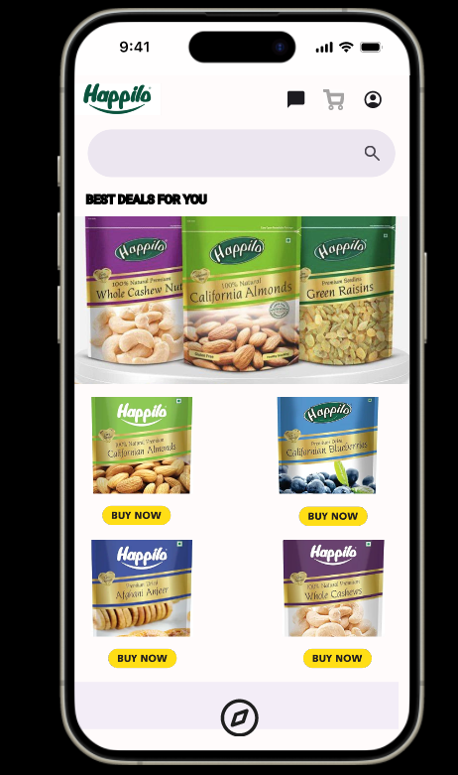
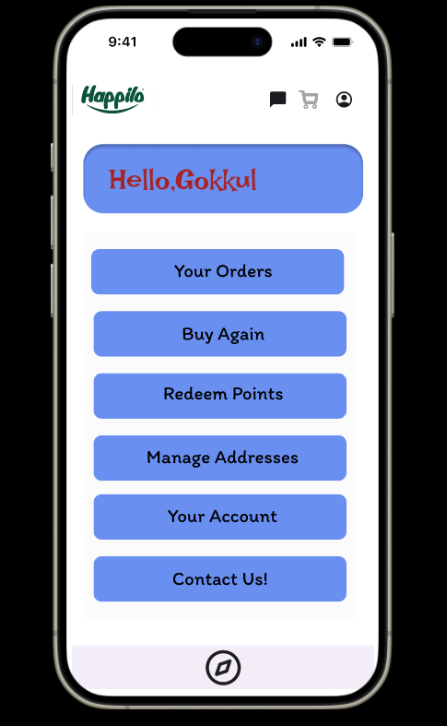
Wire framing
Home Page
Redeem Points

Slide 11
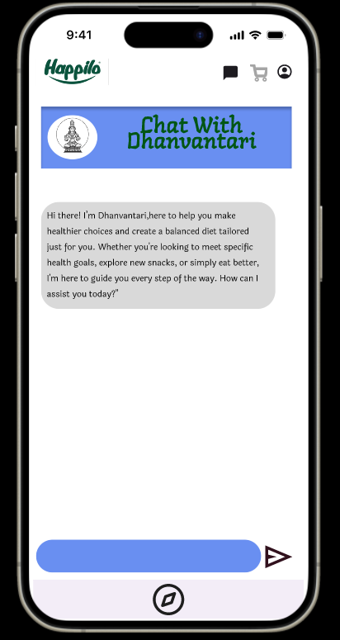
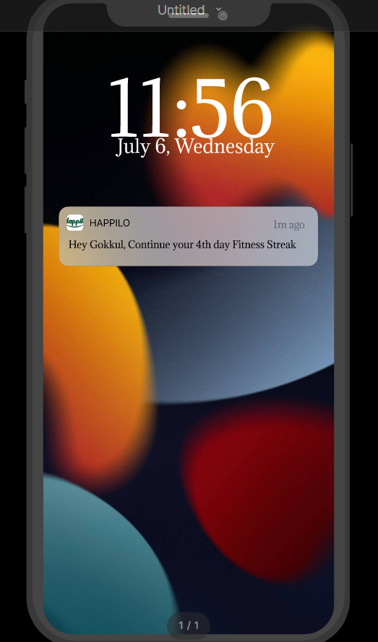
AiBased
Notification
AiBased Nutritionist

Slide 12
Marketing Strategy:
Target Audience:
Demographics: Age 1845, urban dwellers, techsavvy, healthconscious individuals.
Geography: Target Tier 1 and Tier 2 cities in India (e.g., Mumbai, Delhi, Bangalore, Chennai, Hyderabad, Pune, etc.).
Behavior: Interested in health, fitness, and wellness.
Strategy:
The strategy is devised by considering 10 lakh rupees as the initial budget
Digital Advertising (40% of Budget ₹4,00,000)
Google Ads: ₹1,50,000 for search and display ads targeting healthrelated keywords.
Facebook & Instagram Ads: ₹1,50,000 for targeted ads based on interests and behavior.
Influencer Marketing: ₹1,00,000 for collaboration with fitness influencers who can create content and promote the app.
OutofHome (OOH) Advertising (30% of Budget ₹3,00,000)
Billboards: ₹2,00,000 in key locations in Tier 1 cities.
Transit Media: ₹1,00,000 for ads on buses, metro stations, and airports.

Slide 13
Radio Advertising (10% of Budget ₹1,00,000)
FM Radio: ₹1,00,000 for ads on popular FM channels in targeted cities during peak hours.
Print Advertising (10% of Budget ₹1,00,000)
Newspaper Ads: ₹50,000 for ads in health and lifestyle sections of top newspapers.
Magazines: ₹50,000 for ads in popular fitness and wellness magazines.
Event Sponsorships and Collaborations (10% of Budget ₹1,00,000)
Health & Fitness Events: ₹1,00,000 to sponsor local fitness events, marathons, and health camps.
Additional budget of 15 lakhs for, free 150 gm happilo snacks on purchase above 199 for first 10,000 users
Pricing strategy
The app will be free for everyone, as the introduction of initial subscriptionbased use will not attract most of the users.
Performance tracking:
1) User Acquisition Metrics
Downloads: The total number of app downloads from app stores.
Cost Per Install (CPI): The cost incurred for each app install through paid campaigns.
Organic vs. Paid Installs: The ratio of users who discovered the app organically versus through paid marketing efforts.

Slide 14
2)User Engagement Metrics
Active Users: Number of daily active users (DAU) and monthly active users (MAU).
Session Length: The average time users spend on the app per session.
Session Frequency: How often users open the app in a given time period.
Churn Rate: The percentage of users who uninstall or stop using the app after a certain period.
3. User Retention Metrics
Retention Rate: The percentage of users who return to the app after their first session. Track this on a daily, weekly, and monthly basis.
Cohort Analysis: Analyzing user behavior over time based on when they first started using the app to understand longterm retention.
4. Monetization Metrics
InApp Purchases: Revenue generated from inapp purchases or premium features.
Average Revenue Per User (ARPU): The average revenue generated from each active user.
Lifetime Value (LTV): The projected revenue a user will generate over their lifetime as a customer.

Slide 15
5. Customer Satisfaction Metrics
Net Promoter Score (NPS): A measure of user satisfaction and their likelihood to recommend the app to others.
User Reviews and Ratings: Average ratings on app stores and the content of user reviews.
Customer Support Requests: The number and nature of customer support queries or issues, which can indicate user challenges or dissatisfaction.
6. Technical Performance Metrics
Crash Rate: The percentage of app sessions that end due to crashes.
Load Time: The time the app loads on users’ devices.
Error Rate: The frequency of errors encountered by users during app use.
7. Feature Usage Metrics
Most Used Features: Identifying which app features are most frequently used by users.
New Feature Adoption Rate: Tracking how quickly users use newly introduced features.

Slide 16
8. Conversion Metrics
Signup Conversion Rate: The percentage of users who download the app and complete the signup process.
Purchase Conversion Rate: The percentage of users who make a purchase after browsing products or features.
9. Referral and Virality Metrics
Referral Rate: The percentage of users who refer others to the app.
Viral Coefficient: Measures how effectively existing users bring in new users, indicating the potential for organic growth.
10. A/B Testing Results
Experiment Outcomes: The impact of different versions of features, UI changes, or marketing messages on user behavior and key metrics.

